Slide 6
DOWN TO GOD | DOWN TO US

Slide 7
DOWN TO GOD | DOWN TO US
APATHY | ANXIETY
‘LET GO & LET GOD’ | ‘LEAVE IT TO ME’
PURPOSELESS | PRIDE
POINTLESS | DESPAIR

Slide 8
DOWN TO GOD or US | DOWN TO GOD and US
APATHY or ANXIETY | ACTION & FREEDOM
‘LET GO & LET GOD’ or ‘LEAVE IT TO ME’ | DEPENDENCE & DOING
PURPOSELESS or PRIDE | PURPOSEFUL & HUMBLE
POINTLESS or DESPAIR | SECURITY & COMFORT

Slide 9
DOWN TO GOD or US | DOWN TO GOD and US
APATHY or ANXIETY | ACTION & FREEDOM
‘LET GO & LET GOD’ or ‘LEAVE IT TO ME’ | DEPENDENCE & DOING
PURPOSELESS or PRIDE | PURPOSEFUL & HUMBLE
POINTLESS or DESPAIR | SECURITY & COMFORT
GOD’S SOVEREIGNTY & GRACE Work Hard & Rest Well

Slide 10
GOD’S SOVEREIGNTY
I am God, and there is no other; I am God, and there is none like me. I make known the end from the beginning, from ancient times, what is still to come. I say: My purpose will stand, and I will do all that I please. (Isa 46:9-10)
He works out everything in conformity with the purpose of his will.
(Eph 1:11)
The only Potentate, the King of kings, and Lord of lords
(1 Tim 6:15)

Slide 11
The doctrine of God’s Sovereignty lies at the foundation of Christian theology. It is the centre of gravity in the system of Christian truth: the sun around which all the lesser orbs are grouped. It is the golden milestone to which every highway of knowledge leads and from which they all radiate. It is the cord upon which all other doctrines are strung like so many pearls, holding them in place and giving them unity. It is designed as the sheet-anchor for our souls amid the storms of life. The doctrine of God’s Sovereignty is a Divine cordial to refresh our spirits.
A.W. Pink

Slide 12
MAN’S RESPONSIBILITY
Let no one say when he is tempted, "I am being tempted by God," for God cannot be tempted with evil, and he himself tempts no one. But each person is tempted when he is lured and enticed by his own desire. (James 1:13-14).
I call heaven and earth to witness against you today, that I have set before you life and death, blessing and curse. Therefore choose life, that you and your offspring may live, (Deuteronomy 30:19)
You search the Scriptures because you think that in them you have eternal life; and it is they that bear witness about me, yet you refuse to come to me that you may have life. (John 5:39-40)

Slide 13
GOD’S SOVEREIGNTY & MAN’S RESPONSIBILITY
‘for it is God who works in you, both to will and to work for his good pleasure.’
Phil 2:13 NIV

Slide 16
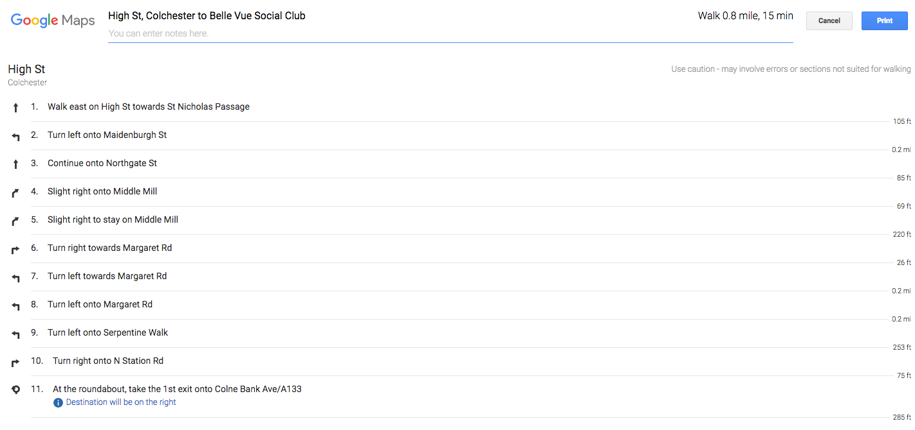

Slide 19
1. FIX OUR DIRECTION

Slide 20
1. FIX OUR DIRECTION
2. WORK HARD & HUMBLY

Slide 21
1. FIX OUR DIRECTION
2. WORK HARD & HUMBLY
3. SLEEP & REST WELL

